Slide 1
AGILE METHODOLOGY
Brandon Lombard
Southern New Hampshire University

Slide 2
ROLES ON A SCRUM-AGILE TEAM
Citation: (Nicholson et al., 2017)
PRODUCT OWNER | SCRUM MASTER | DEVELOPER | TESTER
Conveys the vision of the stakeholders to the team. Communicates with stakeholders about progress or any issues. Have full authority over the team. | Enforce Scrum ceremonies and events. Commits to goals/deadlines on team’s behalf. Commits the team to sprint goals without interfering with the company’s management. Hosts Scrum meetings. | Programs the software for the team. Pick up the items form the Product Backlog to be delivered in the next sprint. Breaks down and provides estimates to Sprint items. | Tests the various stories in the Spring Backlog. Provides feedback on test status, progress, and product quality. Focuses on overall quality of software to remove any bugs or issues within the project.

Slide 3
phases of the SDLC in agile
Project Initiation – This is where the project begins. In this stage, typically the project vision and ROI justification will be discussed (Windsor, 2020). Also, team members, time requirements, and resources will be determined.
Planning – Here the team comes together with the sponsor/product owner to determine what they want in the project. The product backlog is built at the story level. Additionally, risks will be estimated along with an initial release plan.
Development – After the requirements have been ironed out, agile development through phases, sprints, and or iterations begin. By the end of the spring, the developers plan to have a working product complete. Also at this point the testers begin their work to ensure the product is working and within scope of product guidelines.
Production – The product has been deployed and is being used.
Retirement – Product is at the end of life stage, whereas the product is decommissioned and pulled form production (Windsor, 2020).

Slide 4
WHY THE AGILE PHASES ARE IMPORTANT
Project planning is important because without a plan, the product may not turn out as wanted or it may cause a headache down the road during development.
Developing and testing is important so that the product can actually be developed and is up to the standards of the product owner and stakeholders.
Sprint planning is important because it defines what can be delivered in the sprint and how the product's goals will be achieved. Additionally, sprints are important because it is the heart of agile methodologies and allows the team to get a set amount of work done in a specific time period with fewer headaches at the end during its release to the public.
Overall, agile phases keep the team on track and focused on the end goals of the project in an organized manner.

Slide 5
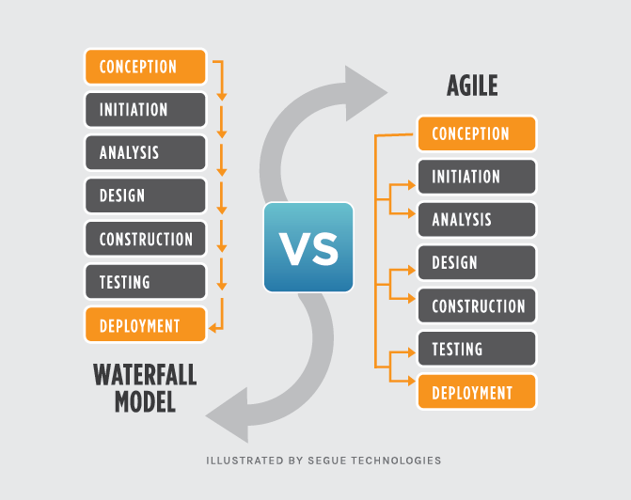
WATERFALL VS. AGILE
Waterfall is the “traditional” approach that plays a sequence of events in order – please see diagram to the right.
Agile is incremental in delivery through team collaboration, sprints, and constant feedback.
Waterfall is more straight forward than agile, where developers and customers agree on deliverables early on and makes progress more easily measured (Lotz, 2018).
With waterfall, the customer may not see the progress until later in the project and this can be costly and difficult to change that late in the process.
With agile, when work is completed it is constantly reviewed and evaluated buy the team while changes and decisions are made and constantly changing(Lotz, 2018).
Agile leaves more room for changes in requirements.

Slide 6
how the process would have been different with a waterfall development approach
My projects may have been more organized with a clearer understanding of the requirements early on. This is because waterfall is a structured approach not fully designed to have many changes, while agile welcomes constant changes. However, if changes are required during waterfall, it is considerably harder to make said changes over agile.
Without agile, there wouldn’t have been such in depth communication with the stakeholders and that may cause problems. This mis because the waterfall method doesn’t typically showcase the work to them very early on.
Overall, it is better using agile because it allows for more changes and keeps the entire team in the loop throughout the whole process.

Slide 7
Factors to consider when choosing agile or waterfall
If you have a clearly defined project with clearly set deadlines and deliverables with well documented and understood project planning, waterfall is a better system.
The waterfall method allows for less confusion throughout the development process, yet has one straight path, and if the project doesn’t appease the stakeholders, it is difficult to make changes.
If there isn’t a completely clear outlook on the project and there may be constant changes in requirements, then agile is the right choice.
Agile allows for the whole team to always be in the loop and understanding of the constant changes. However, this method can be more confusing and at times more time consuming.

Slide 8
REFERENCES
Nicholson, S., Subramoniam, R., Wijetunge, R., &amp; Harrin, E. (2017, July 4). What are the important Agile Scrum Roles And Responsibilities? Knowledgehut. https://www.knowledgehut.com/blog/agile/agile-scrum-roles-responsibilities.
Windsor, G. (2020, February 28). 5 stages of the Agile System Development Life Cycle - BrightWork.com. Medium. https://medium.com/brightwork-collaborative-project-management-blog/5-stages-of-the-agile-system-development-life-cycle-brightwork-com-a207bdf61696.
Lotz, M. (2018, November 20). Waterfall vs. Agile: Which Methodology is Right for Your Project? Segue Technologies. https://www.seguetech.com/waterfall-vs-agile-methodology/.

